Slide 1
Deliverable 2
SuperSpheres

Slide 2
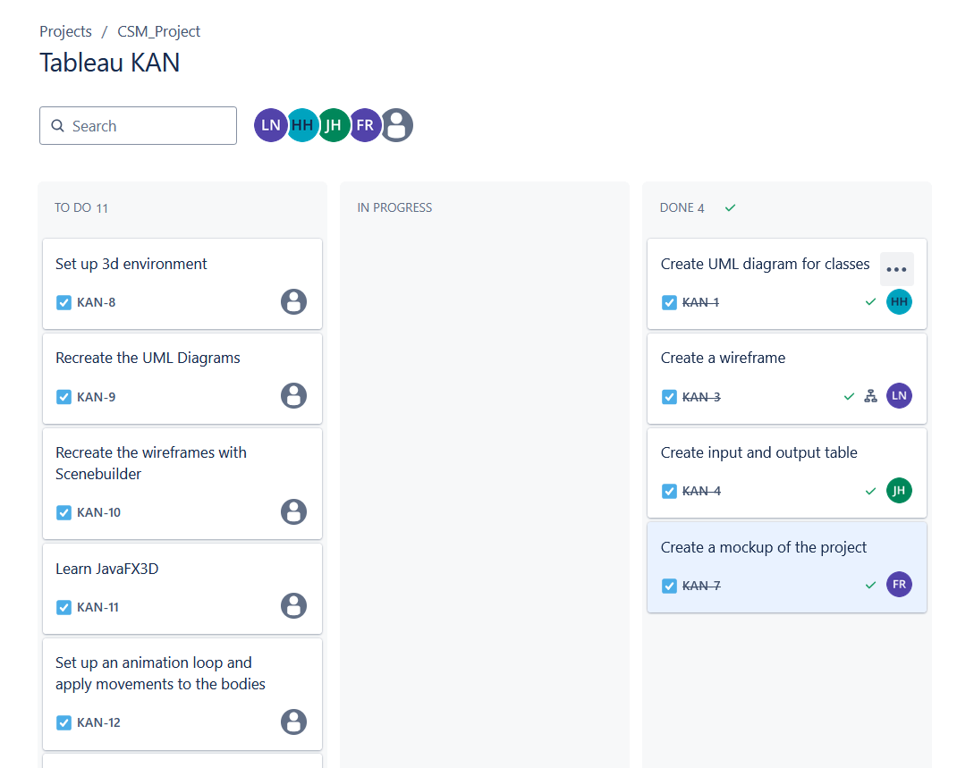
Task breakdown

Slide 3
Sprint report
User | Received Stories | Resolved Stories | Carry Over Stories | Blocked Stories
Josue Joseph Forestal | Create UML diagram for classes | Create UML diagram for classes
Le Tuan Huy Nguyen | Create a wireframe | Create a wireframe
Jameel Hassan | Create input and output table | Create input and output table
Fadi Rasmy | Create a mockup using Figma | Create a mockup using Figma

Slide 4
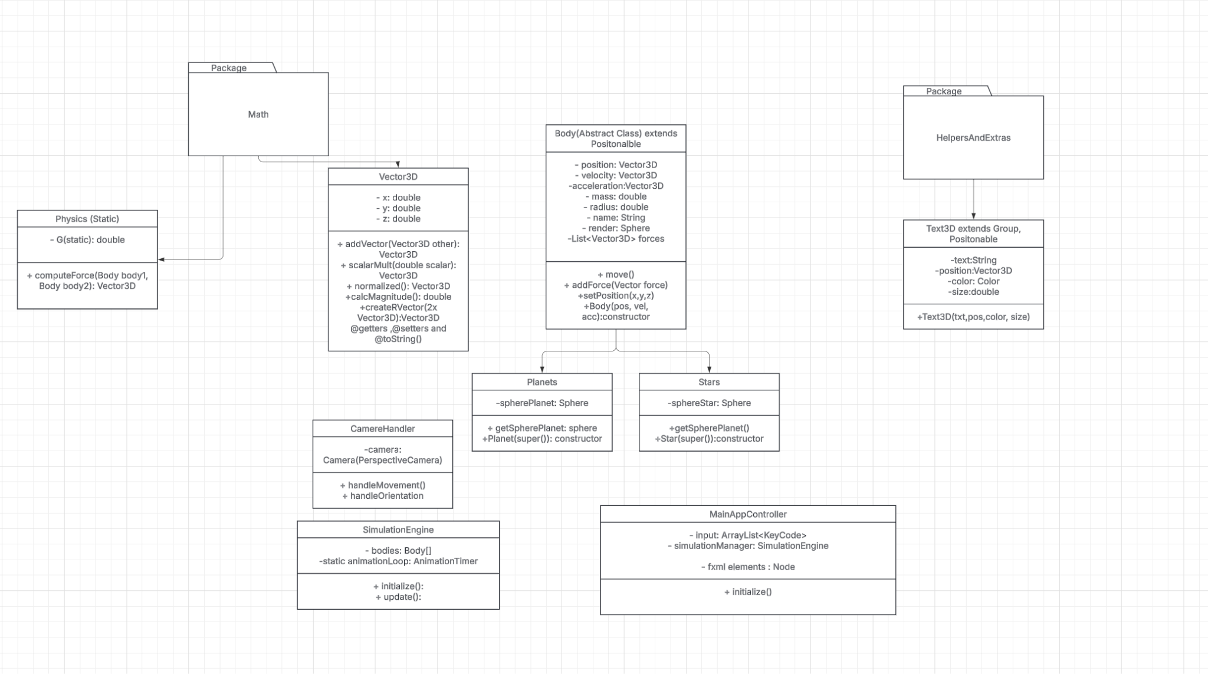
UML

Slide 5
Input & outputs

Slide 6

Input | Output
Create new planet | Opens planet creation menu
(In planet creation menu) Input new planet mass ( __ kg) | Decides new planet mass
(In planet creation menu) Input new planet velocity ( __ m/s) | Decides new planet velocity
(In planet creation menu) Input new planet radius (__km) | Decides new planet radius
(In planet creation menu) Create | Adds planet to toolbar with selected parameters, closes creation menu
Hold left-click on a planet in the toolbar and drag into simulation. Release left-click. | Adds planets into the simulation. Spawn location depends on cursor location when left-click was released.
Left-click on planet | Select the planet. Camera locks onto selected planet
Left-click on empty space | If a planet was selected, deselects planet. Free movement to camera returns.
Modify selected planet mass ( __ kg) | Adjusts selected planet mass
Modify selected planet Velocity ( __ m/s) | Adjusts selected planet velocity
Press W, A, S, D | Moves camera position in the simulation
Hold right-click and move mouse | Changes camera angle in simulation

Slide 7
Wireframes and Mockups

Slide 8
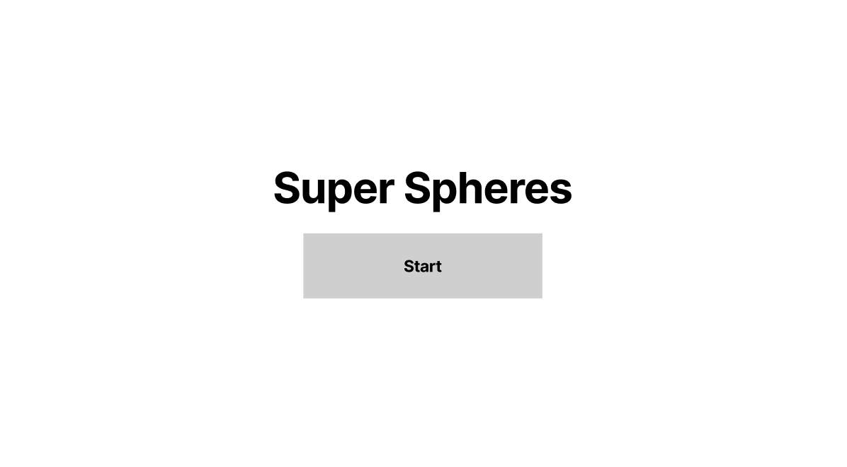

Slide 9
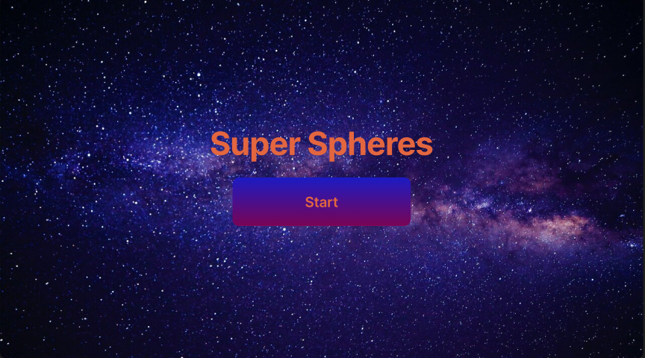

Slide 10
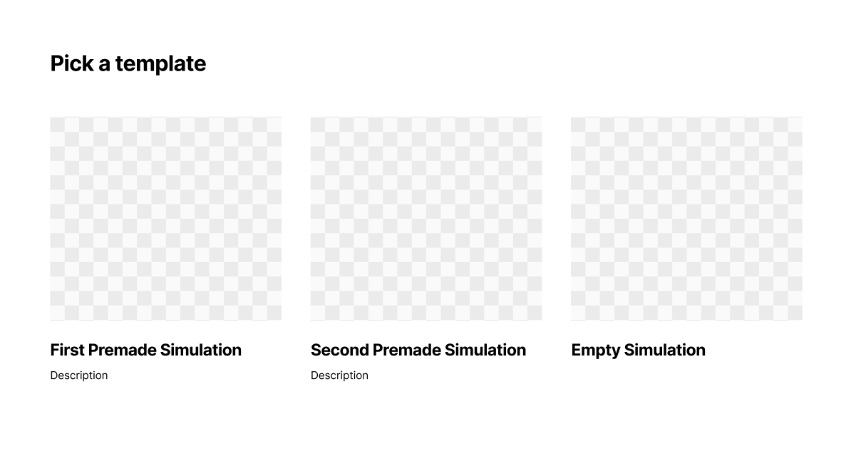

Slide 11
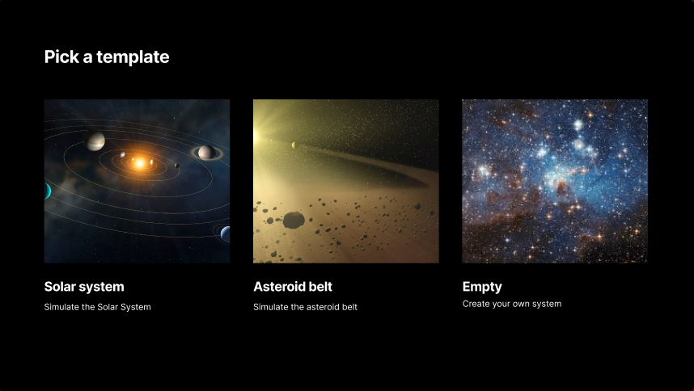

Slide 12
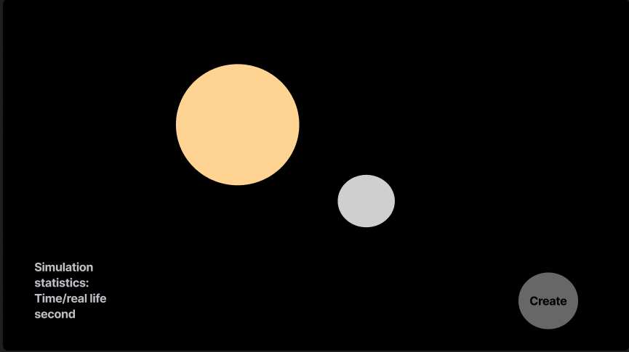

Slide 13
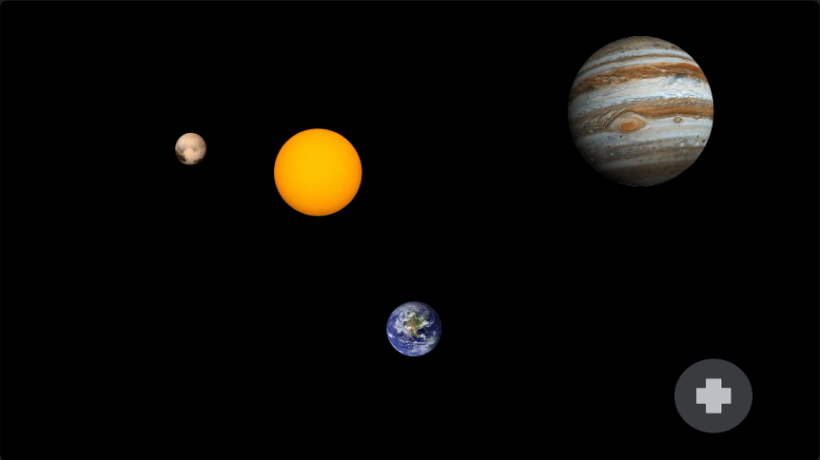
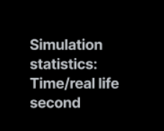

Slide 14
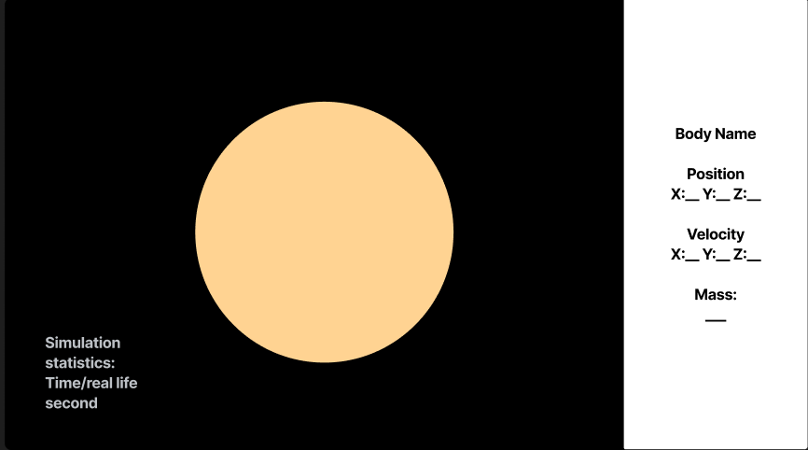

Slide 15
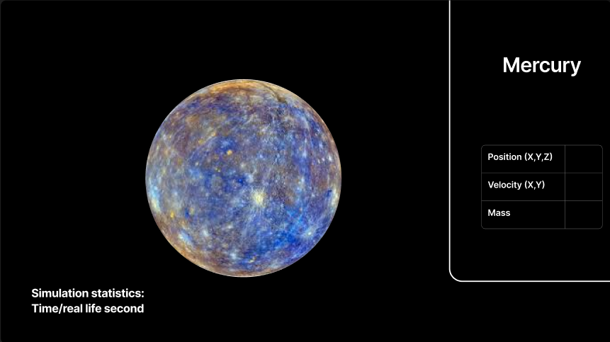

Slide 16
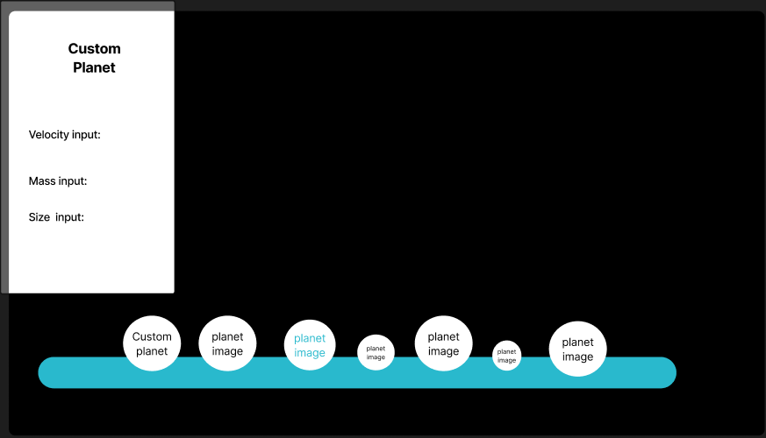

Slide 17
